Slide 1
Trigonometry
8-7 Applications of Right Triangle Trigonometry

Slide 2
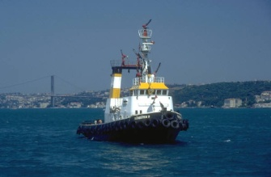
horizontal
Angle of depression
Angle of elevation
horizontal
≅
Angle of elevation
Angle of depression

Slide 3
If the top of the lighthouse is 25 m above sea level and the angle of depression is 2° find the distance between the boat and the base of the lighthouse.

Slide 5
Practice Assignments
CW: pp. 317-318 1-7
HW: pp. 318-319 1-12
CHAPTER 8 TEST FRIDAY

