Slide 1
11-2 Areas of Parallelograms, Triangles, and Rhombuses
Theorem 11-2
The area of a parallelogram equals the product of a base and the height to that base. (A = bh)
b
h

Slide 2
Theorem 11-3
The area of a triangle equals half the product of a base and the height to that base.
$A=\frac{1}{2}bh$
h
b

Slide 3
Theorem 11-4
The area of a rhombus equals half the product of the diagonals.
$A=\frac{1}{2}d_{1}d_{2}$
d₂
d₁

Slide 4
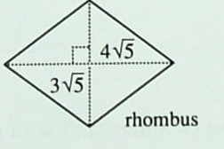
Practice

Slide 5
Assignments
CW: p. 431 4-9 (top of the page)
HW: pp. 431-433 #2-36 even
YOU MUST SHOW WORK!

