Slide 1
Chapter 9 Circles
9.4 Arcs and Chords
Objective: I will be able to apply theorems about the chords of a circle.
Created by Mr. Richard Madolid

Slide 2
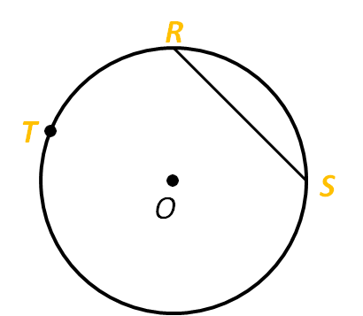
Arcs of Chords
The arc of the chord
is considered the
minor arc that is
formed by the chord.
Minor arc RS
Major arc RTS
The arc that is formed by chord is minor arc RS

Slide 3
Theorem 9 – 4
In the same circle or in congruent circles:
Congruent arcs have congruent chords.
Congruent chords have congruent arcs.
R
T
55
17
55
•
17
S
O
V

Slide 4
Example 1
Find the value of chord
R
T
75
75
•
15
S
O
V

Slide 5
Example 2
Find the value of minor arc RS
R
T
12
60
•
12
S
O
V

Slide 6
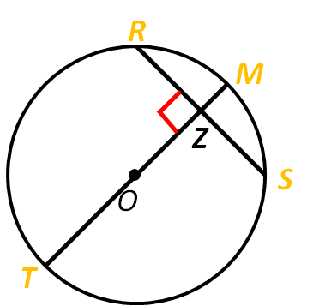
Theorem 9 – 5
A diameter that is perpendicular to a chord bisects the chord and its arc.
50
3
50
3

Slide 7
Example 3
Find the value of segment
Find the value of minor arc RS
45
7
45
7

Slide 8
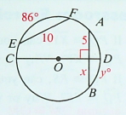
Example 4
Find the value of x
Find the value of y

Slide 9
RECALL
Recall that the distance from a point to a line is the length of the perpendicular segment from the point to the line.
A

Slide 10
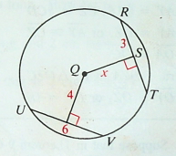
Theorem 9 - 6
In the same circle or in congruent circles:
Chords equally distant from the center (or centers) are congruent.
Congruent chords are equally distant from the center (or centers).
3

Slide 11
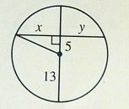
Example 5
Find the value of x
Find the value of y

Slide 12
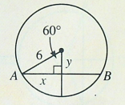
Example 6
Find the value of x
Find the value of y

Slide 13
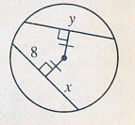
Example 7
Find the value of x
Find the value of y

