Slide 1
Chapter 8 Review
Team Practice

Slide 2
Question 1
Find the geometric mean between $\frac{2}{9} \text{and} \frac{3}{9}$. (No decimal answers.)
1.5 minute

Slide 3
Question 2
Solve for x. (No decimals.)
2 minutes

Slide 4
Question 3
Solve for x. (No decimals.)
1 minute

Slide 5
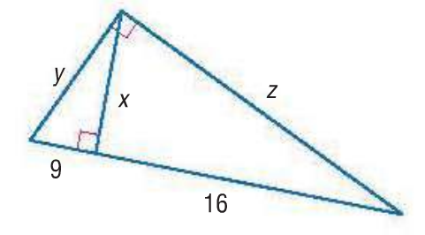
Question 4
Find x, y, and z. (No decimals.)
2 minutes

Slide 6
Question 5
Find x. (No decimals.)
x
21
30
1 minute

Slide 7
Question 6
Find x and y. (No decimals.)
1 minute

Slide 8
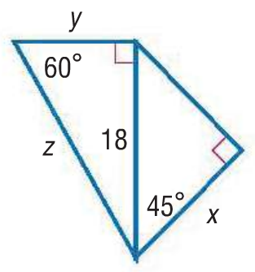
Question 7
Find x, y and z. (No decimals.)
2 minutes

Slide 9
Question 8
Is a triangle with the given lengths of sides acute, right or obtuse?
7, 15, 21
1 minute

Slide 10
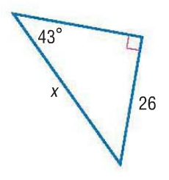
Question 9
Find x to the nearest tenth.
1 minute

Slide 11
Question 10
A tree casts a shadow 21 m long. The angle of elevation of the sun is 51°. To the nearest meter, what is the height of the tree?
3 minutes

Slide 12
Question 13
The shorter diagonal of a rhombus with a 70° angle is 122 cm long. How long, to the nearest centimeter, is the longer diagonal?
3 minutes

Slide 13
Question 11
Find x and y to the nearest tenths.
3 minutes

Slide 14
Question 14
A helicopter is hovering over a landing pad 100 m from where you are standing. The helicopter’s angle of elevation with the ground is 12°. What is the altitude of the helicopter?
3 minutes

