Slide 1
Trigonometry
8-5 The Tangent Ratio

Slide 2
The Tangent ratio
Right triangle trigonometry
Three ratios:
Tangent of an angle (tanA)
Sine of an angle (sinA)
Cosine of an angle (cosA)
Tangent of ∠A (one of the acute angles)
B
opposite leg
A
C
adjacent leg

Slide 3
Tangent of angle A
 | leg opposite ∠A
tangent of ∠A =
 | leg adjacent to ∠A
B
opposite leg
A
C
adjacent leg

Slide 4
ExAMPLES: find the following ratios
Find tan X
Find tan Y
Find tan 30°
Find tan 60°
Z
30°
15
8
X
17
Y
6

Slide 5
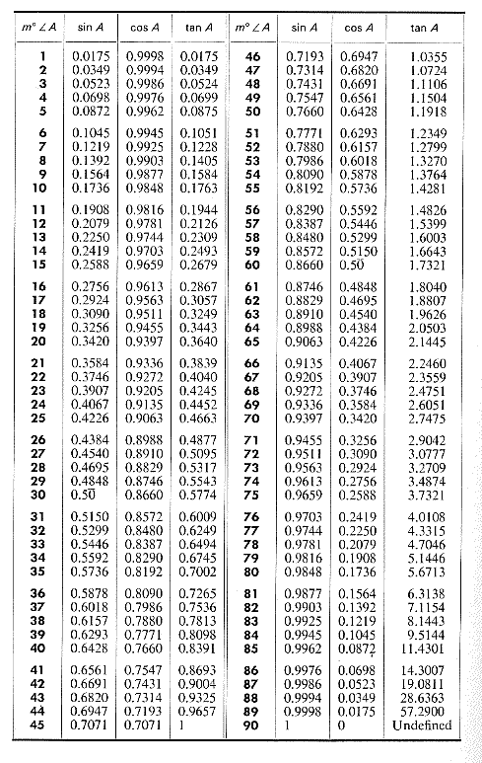
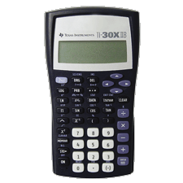
Table of trigonometric ratios (p. 311)

Slide 6
Find the value of y to the nearest tenth.
y
56°
32

Slide 7
The grade of a road is the ratio of its rise to its run and is usually given as a decimal or percent. Find the angle that the road makes with the horizontal if its grade is 4%.
rise
grade =
run
rise
x°
run
tan x° = 0.0400

Slide 8
Practice Assignment
CW: p. 306 1-9, p. 309, 19
HW: p. 308-310 2-26 even, 29

